Slide 1
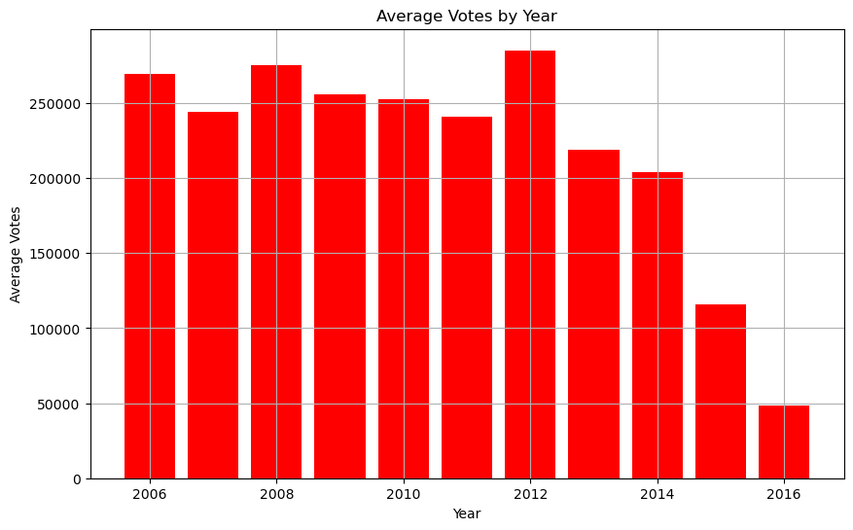
#show variation btw year had the highest average voting avg_votes_per_yr = data.groupby('Year')['Votes'].mean() plt.figure(figsize = (10,6)) plt.bar(avg_votes_per_yr.index, avg_votes_per_yr.values, color = 'red') plt.xlabel('Year') plt.ylabel('Average Votes') plt.title('Average Votes by Year') plt.grid(True) plt.show()

Slide 2
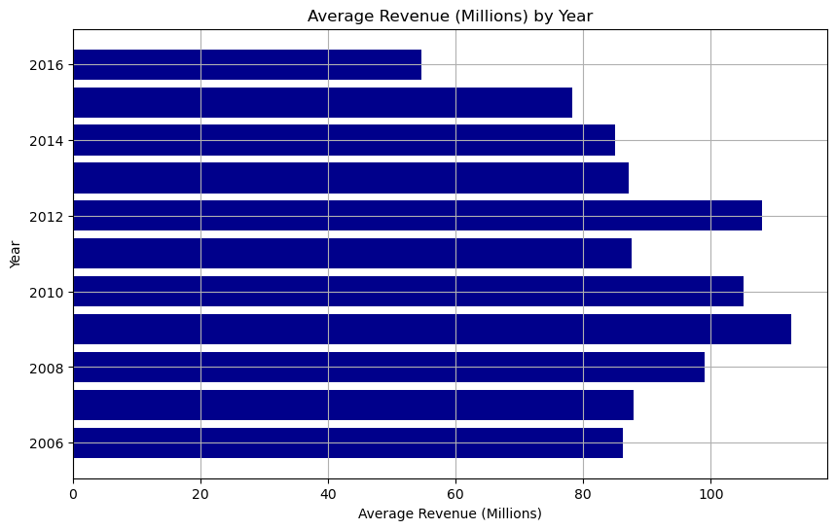
#Graphical display of variation between year and highest average revenue avg_revenue_per_yr = data.groupby('Year')['Revenue (Millions)'].mean() plt.figure(figsize = (10,6)) plt.barh(avg_revenue_per_yr.index, avg_revenue_per_yr.values, color = 'darkblue') plt.xlabel('Average Revenue (Millions)') plt.ylabel('Year') plt.title('Average Revenue (Millions) by Year') plt.grid(True) plt.show()

Slide 3
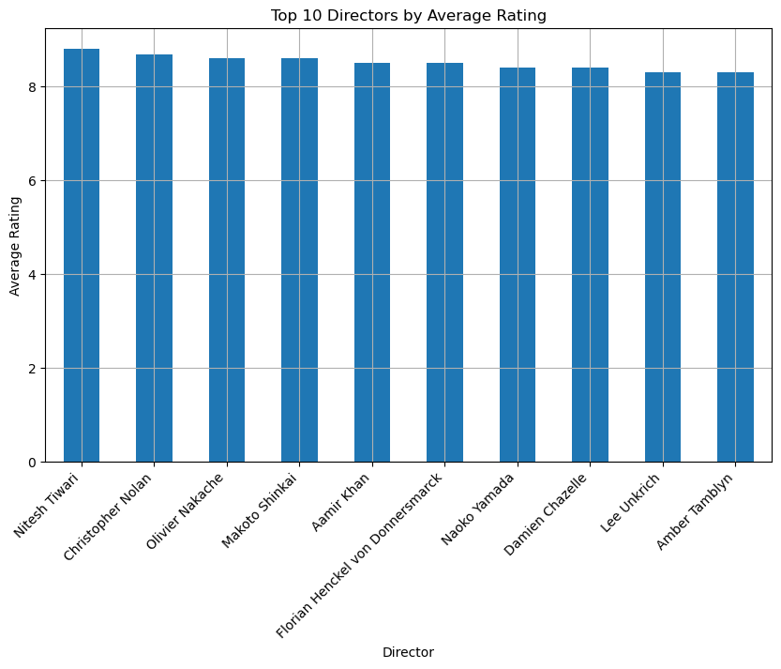
plt.figure(figsize = (10,6)) top_10_directors.plot(kind = 'bar') plt.xlabel('Director') plt.ylabel('Average Rating') plt.title('Top 10 Directors by Average Rating') plt.xticks(rotation=45, ha = 'right') plt.grid(True) plt.show()

Slide 4
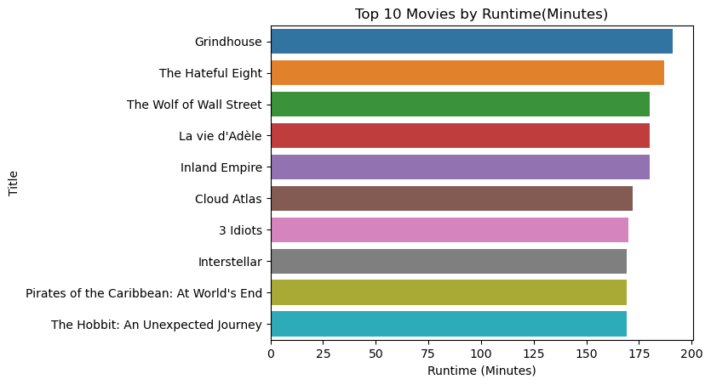
sns.barplot(x='Runtime (Minutes)', y=Top10_len.index, data=Top10_len) plt.title('Top 10 Movies by Runtime(Minutes)') plt.show()

Slide 5
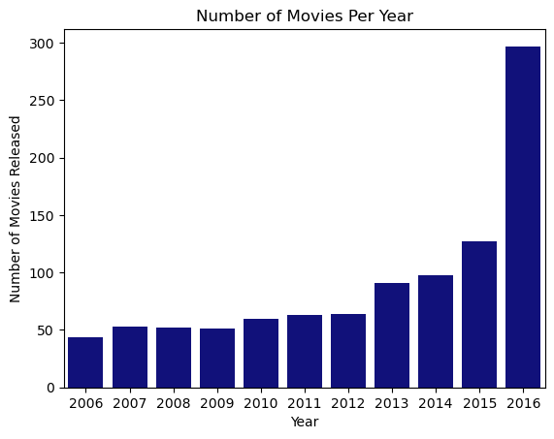
sns.countplot(x='Year', data=data, color = 'darkblue') plt.ylabel('Number of Movies Released') plt.title('Number of Movies Per Year') plt.show()

Slide 6
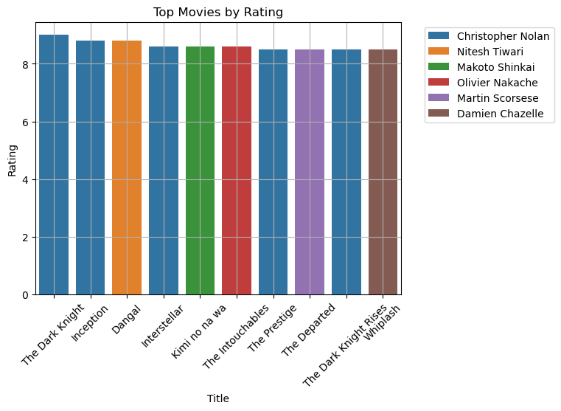
sns.barplot(x=Top10_len.index, y='Rating', data=Top10_len, hue='Director', dodge=False) plt.legend(bbox_to_anchor=(1.05,1), loc=2) plt.xlabel('Title') plt.ylabel('Rating') plt.title('Top Movies by Rating') plt.xticks(rotation = 45) plt.grid(True) plt.show()

Slide 7
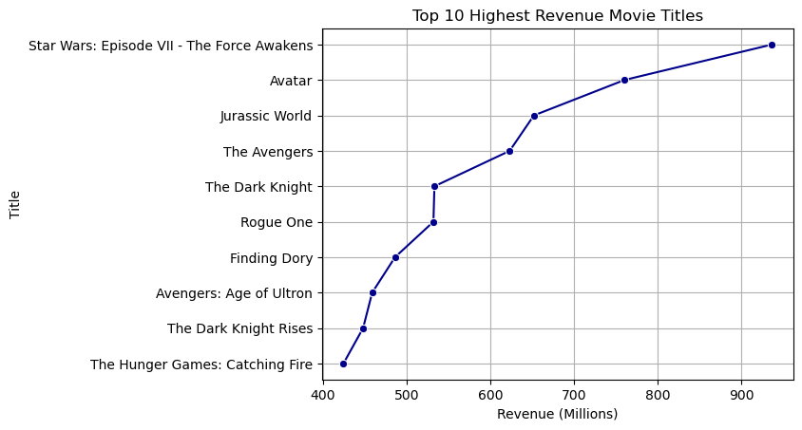
sns.lineplot(x='Revenue (Millions)',y=Top_10.index, data=Top_10, marker ='o', color = 'darkblue') plt.grid(True) plt.title('Top 10 Highest Revenue Movie Titles') plt.show()

Slide 8
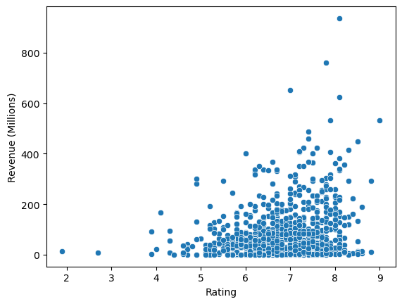
#Does rating affect revenue sns.scatterplot(x='Rating',y='Revenue (Millions)', data=data) plt.show()

Slide 9
ANALYSIS & RECOMMENDATIONS
From the scatterplot, movies that were rated the highest, generated the most
revenue.
Films of the top 2 actors that should be looked out for are “Christopher Nolan” and “Nitesh Tiwan” because they generated the most revenue.

